Slide 1
M270C Project Presentation
Xiaochen Li

Slide 2
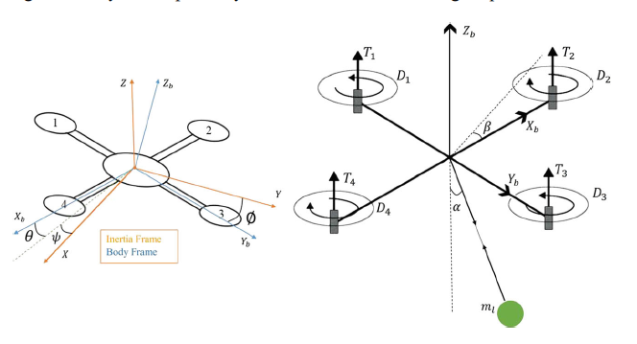
Problem Description
Finding the Optimal Trajectory for Quadrotor with Cable-Suspended Load
Ensure the trip is safe and efficient
Find the maximum payload allowed

Slide 3



Problem Formulation:
Derive the dynamic using Euler-Langrange:
Applying Pontryagin’s Minimum Principle
Define cost functional J
Optimization problem -> Two Point Boundary Value Problem (TPBVP)

Slide 4
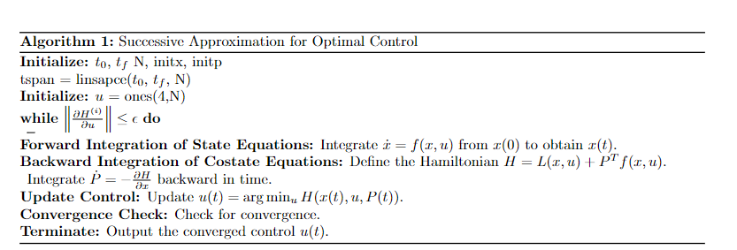
Methods
Successive Approximation:
Provide initial guess of control input u
Integrate system dynamics with this guess with time
Integrate costate with reverse in time by plugging states x and control input u
Update u by evaluating min H(t, x, u)
Stop until converge

Slide 5
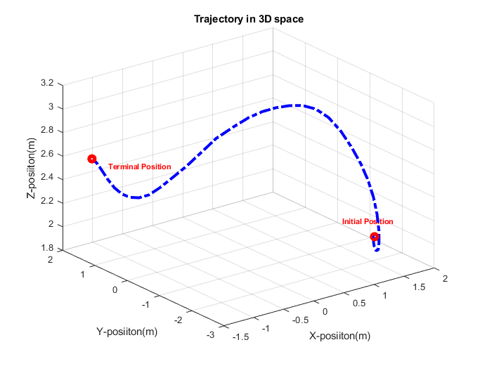
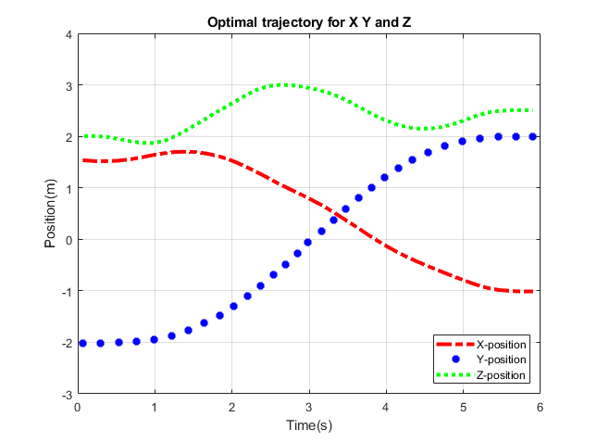
Results
Initial Position: [1.5, -2 2]
Terminal Position: [-1, 2, 2.5]
Max payload: 0.28kg

